Slide 1

Umich
Mental Health Application
Kashmira Sawant

Slide 2
Problem Statement:
​​The graduate students at the University of Michigan should be able to get access to a smart mental health and wellness services that will help them to manage daily mental health challenges without being restricted by the unavailability of a mobile platform or the additional waiting and plodding that a traditional care model necessitates.
Intended Users:
1. Graduate students in a professional degree program.
2. Domestic students who purchased Domestic Student Health Insurance or international students who purchased the International Student and Scholar Health Insurance.

Slide 3

A walk-through MHealthy

Slide 4
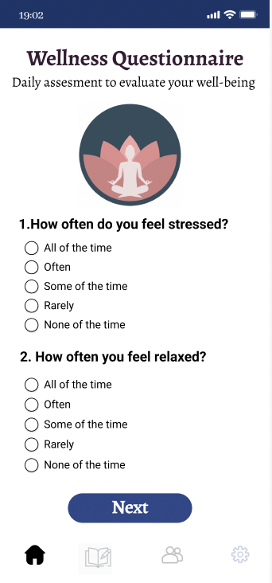
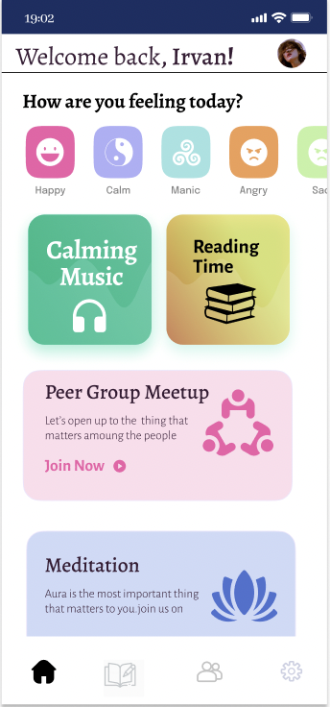
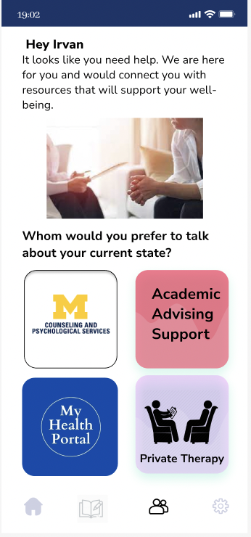
Key Features:
Questionnaire screen
Home screen
Appointment screen

Slide 5
Strategy for Intervention
The Behavioral Change Theories (BCT) of Goal Setting, Social Support, and Scheduled Consequences will be applied by MHealthy.
Users will be required to complete a wellness assessment survey after installing the app to establish a baseline and set goals for monitoring progress or regression.
To develop a customized intervention strategy, it is essential to identify the consumer's potential mental health difficulties.

Slide 6
Conclusion
MHealthy proposes to be a one stop platform for mental health and wellness for graduate students of University of Michigan - Ann Arbor. MHealthy will serve the 18,000 graduate students with domestic or international health insurance. It will incorporate behavior change theories such as goal setting, scheduled consequences/rewards, and social support as well as a telehealth feature that helps consumers to connect with therapists.

